Slide 1
SISTEMAS OPERATIVOS
SO
E – M 2019

Slide 2
Memory Management
Main Memory (cont.)

Slide 3
Paging
Physical address space of a process can be noncontiguous; process is allocated physical memory whenever the latter is available
Avoids external fragmentation
Avoids problem of varying sized memory chunks
Divide physical memory into fixed-sized blocks called frames
Size is power of 2, between 512 bytes and 16 Mbytes
Divide logical memory into blocks of same size called pages
Keep track of all free frames
To run a program of size N pages, need to find N free frames and load program
Set up a page table to translate logical to physical addresses
Backing store likewise split into pages
Still have Internal fragmentation

Slide 4
Address Translation Scheme
Address generated by CPU is divided into:
Page number (p) – used as an index into a page table which contains base address of each page in physical memory
Page offset (d) – combined with base address to define the physical memory address that is sent to the memory unit
For given logical address space 2^{m} and page size 2^{n}

Slide 5
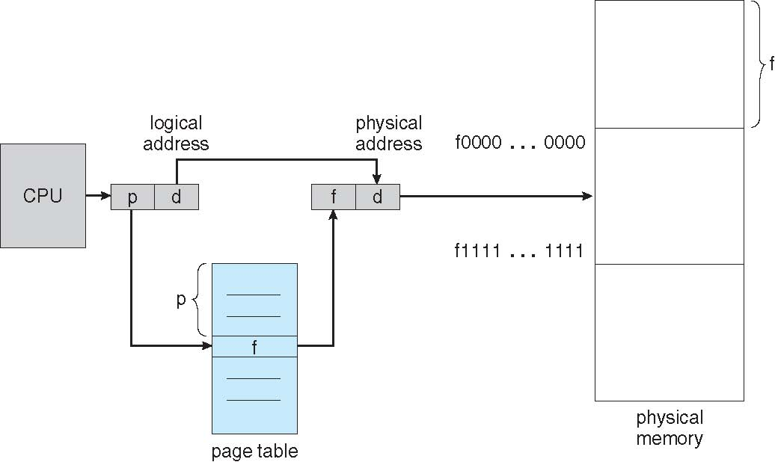
Paging Hardware

Slide 6
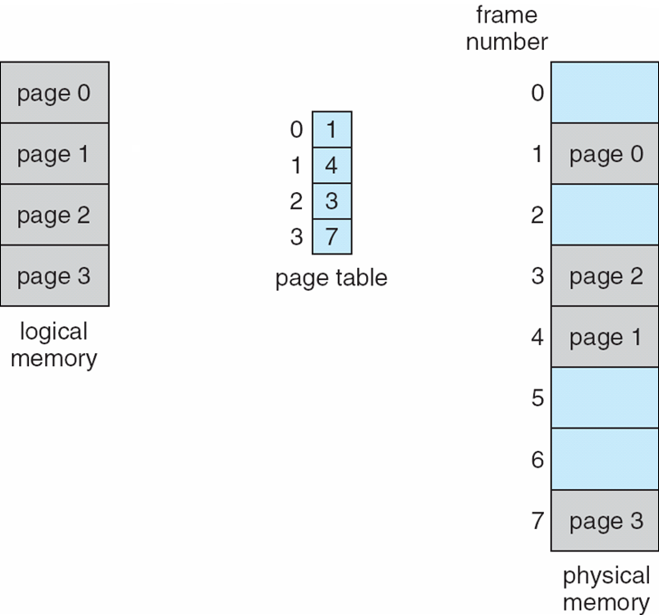
Paging Model of Logical and Physical Memory

Slide 7
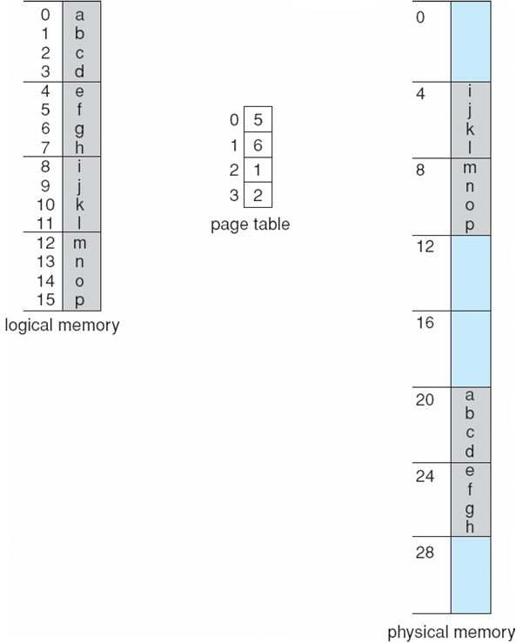
Paging Example - 1
n=2 and m=4 :
16-byte memory, and 4-byte pages

Slide 8
Paging Example - 2
Calculating internal fragmentation
Page size = 2,048 bytes
Process size = 72,766 bytes
35 pages + 1,086 bytes
Internal fragmentation of 2,048 - 1,086 = 962 bytes
Worst case fragmentation = 1 frame – 1 byte
On average fragmentation = 1 / 2 frame size
So small frame sizes desirable?
But each page table entry takes memory to track
Page sizes growing over time
Solaris supports two page sizes – 8 KB and 4 MB
Process view and physical memory now very different
By implementation process can only access its own memory

Slide 9
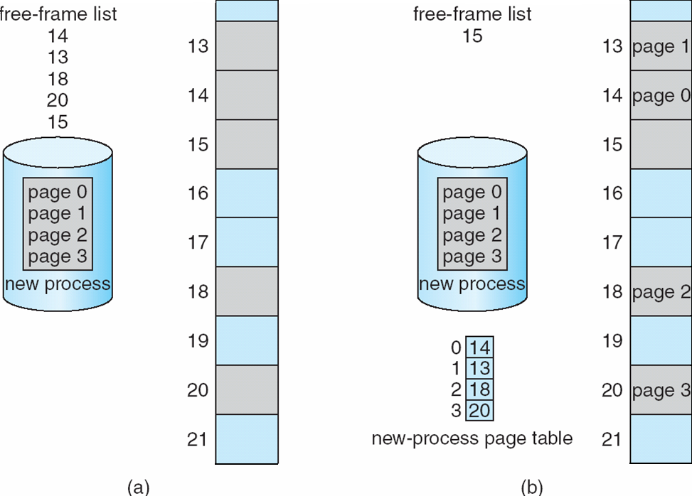
Free Frames

Slide 10
References
Presentación de Ramon Ríos.
Capítulos: Operating System Concepts; Silberschatz, Galvin, Gagne.
14-may-2019

